Slide 1

ECON251 Trade and industry
Lecture 07
New trade regimes and practices

Slide 2

The various outward oriented growth approach discussed in lecture 5 and 6 cannot sufficiently explain why Asia is in the global limelight of growth and development New trade theories and phenomenon emerged . International production, trade and investments are increasingly organised within so-called global value chains (GVCs) where the different stages of the production process are located across different countries. Key diagrams and charts are extracted from The World Bank report : Trading for Development in the Age of Global Value Chains (Vol. 2 of 2)
1. Introduction
Video link: https://youtu.be/B3JGqsL7tA4?feature=shared

Slide 3

Review of Asia’s Outward Growth Strategies
FDI
EPZ
Regionalisation
Global Value Chain

Slide 4
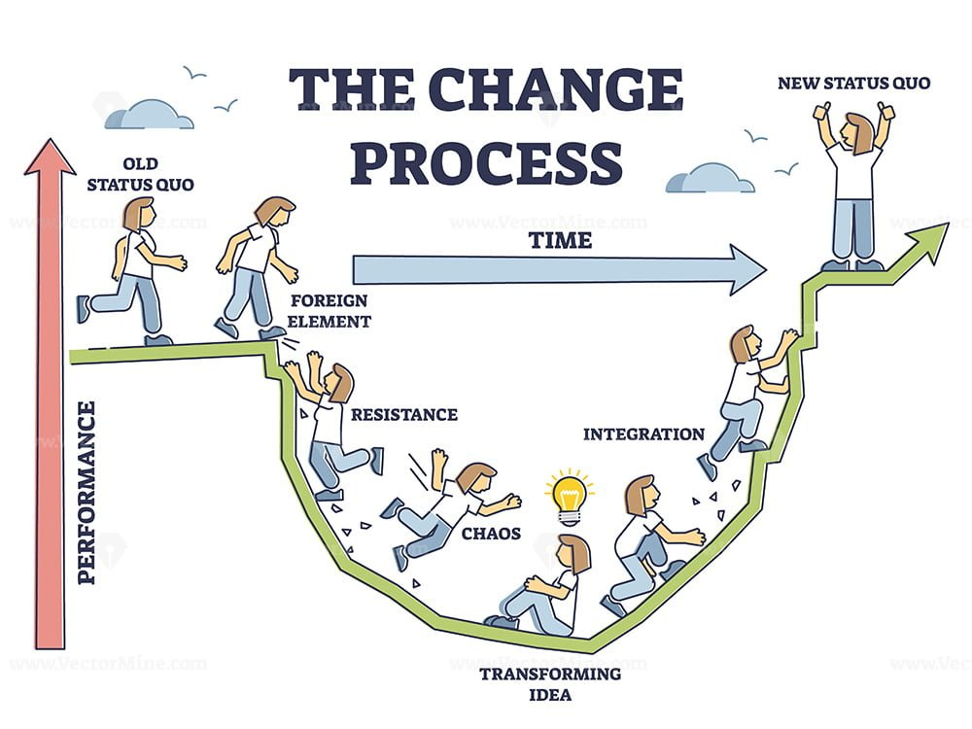
1.2 Introduction
Changing face of trade

Slide 5
2. Global value chain (GVC) Basics
Refers to the full range of activities that companies and workers engage in to bring a product or service from its conception to its end use and beyond, with these activities being geographically dispersed across different countries.
Resource rich countries
But low A, FDI
Labour abundant with trade infrastructure
new
Traditional trade : all within a country

Slide 6
2. Global value chain (GVC) Basics
Key characteristics of a GVC
Fragmentation of Production
International Division of Labor
Interdependence
Value Addition Across Borders

Slide 7
2.1 Global value chain (GVC) Basics
Fragmentation of Production:
The production process is broken down into discrete tasks or stages, which can then be located wherever it is most efficient or advantageous (e.g., lower labor costs, access to specific raw materials, specialized expertise).
Although we are viewing 3 stages of production
But in actual fact, in each stage , there can be tens and hundreds of processes

Slide 8
2.2 Fragmentation of process
various stages of its creation—such as research and development, design, sourcing of raw materials, production of components, assembly, marketing, distribution, and after-sales service—are carried out in different countries around the world.
And notably it includes a large section of services
Service
Service
Consider the role of BIG DATA

Slide 9
2.3 Role of Service in the GVC

Slide 10
2.4 Global value chain (GVC) Basics
Key characteristics of a GVC include:
International Division of Labor: Different countries and firms specialize in specific tasks or segments of the value chain, leveraging their comparative advantages, as explained by Hecksher Olin theorem

Slide 11
2.5 Global value chain (GVC) Basics
Key characteristics of a GVC include:
Interdependence: The various stages and actors in the GVC are highly interconnected and dependent on each other to deliver the final product or service.
Value Addition Across Borders: Each activity performed in a different country adds value to the product as it moves through the chain.

Slide 12
2.6 Global value chain (GVC) Basics
Key characteristics of a GVC include:
Value Addition Across Borders: Each activity performed in a different country adds value to the product as it moves through the chain.
Input Value
Processing
Output value
Value added (VA) = Output value – Input value

Slide 13

2.6.1 Basics of GVC : Value added
Other video resource: https://youtu.be/_sY8nbtDTTY

Slide 14
2.6. 3 GVC Basics : An Example
An Asian Development Bank Institute study reports that China exported Apple iPhones to the U.S. at a unit price of US$ 179.
Of each unit’s total value of US$ 179, approximately US$ 172 consisted of costs for imports of foreign inputs or parts (mostly from Japan, the Republic of Korea, Germany and the U.S.), i.e. the value added in China only represented US$ 7.0
China
Country A
Country B (Parts/Components
Country C (design and technology)
Country D
Ie a mere 4%
US $179
World market
Notes:
50, 22, 50, 50 = $172

Slide 15
3. GVC Participation Index
Backward GVC Participation (Imported Content of Exports):
This measures the share of foreign value-added (imported intermediate inputs) in a country's gross exports.
A higher backward participation indicates a greater reliance on imported components for producing goods and services for export.
Forward GVC Participation (Domestic Value-Added in Foreign Exports): This measures the share of a country's domestic value-added (its own produced intermediate goods and services) that is then used as inputs by other countries to produce their own exports.
A higher forward participation indicates a country's role as a supplier of intermediate goods or services to other countries' GVCs.
Using our smartphone production example

Slide 16
3.1 GVC Basics : An Example
Computing GVC participation using backward participation index
= foreign input value / local export value
= $172/179 X 100% = 96.1%
That will be considered a high backward participation rate
Forward participation rate = 0% [Given the final product is exported from china)
China
Country A
Country B (Parts/Components
Country C (design and technology)
Country D
US $179
Input value = $172
World market
Notes:
50, 22, 50, 50 = $172

Slide 17
3.2 GVC Basics : Revised Example
Computing GVC participation using backward participation index in China
= foreign input value / local export value
= $172/179 X 100% = 96.1%
That will be considered a high backward participation rate
Forward participation rate = $7/179 = 3.9%
China
Country A
Country B (Parts/Components
Country C (design and technology)
Country D
Singapore
Input value = $179
World market
US $200
Computing GVC participation using backward participation index in Singapore
= foreign input value / local export value
= $179/200 X 100% = 89.5%
That will be considered an even higher backward participation rate
Forward participation rate = 0 %
Input value = $172
Notes:
50, 22, 50, 50 = $172

Slide 18
3.3 Implication of the GVC participation rate
A high backward participation rate suggest a high dependency of foreign partners to supply parts or intermediate goods to the country . The country will be more vulnerable to supply chain shocks
How can we possibly reduce this backward participation rate?
Near shoring : ie regionalisation
Spread the risk with more diversification of suppliers
Hold larger buffer stock

Slide 19
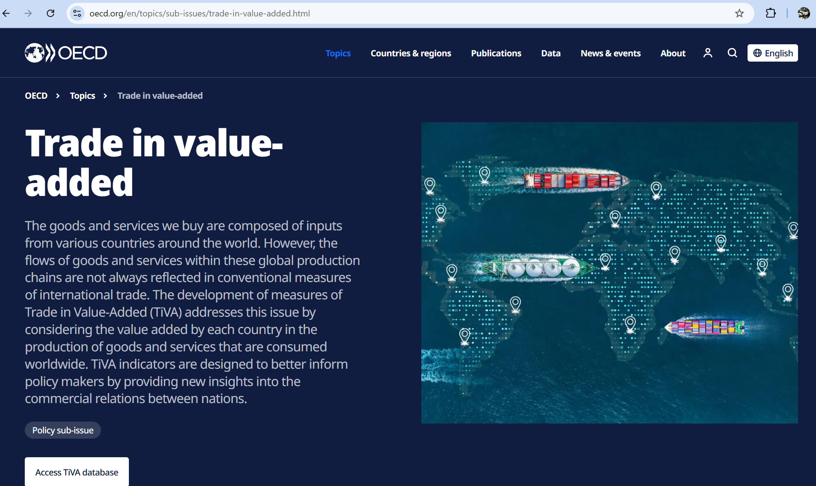
3.4 Key data site
We will navigate and extract the data in tutorial 03

Slide 20
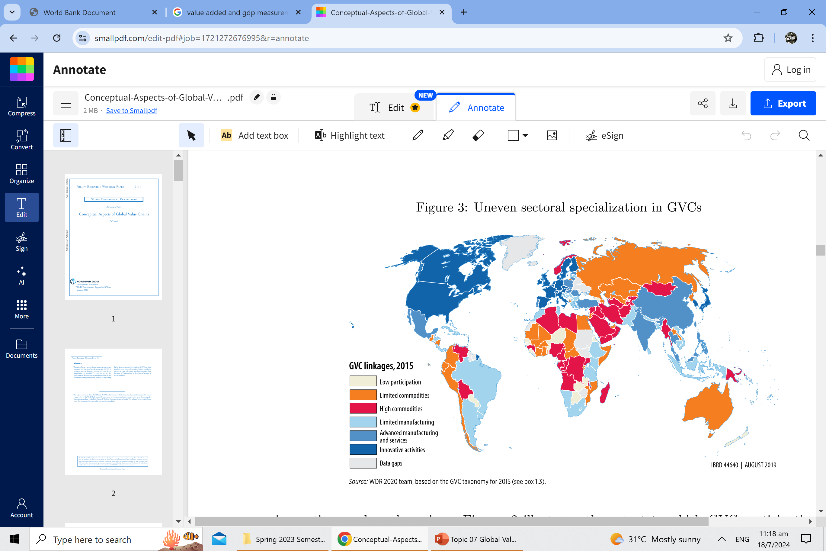
3.4.1 Effects of GVC : Global perspective

Slide 21
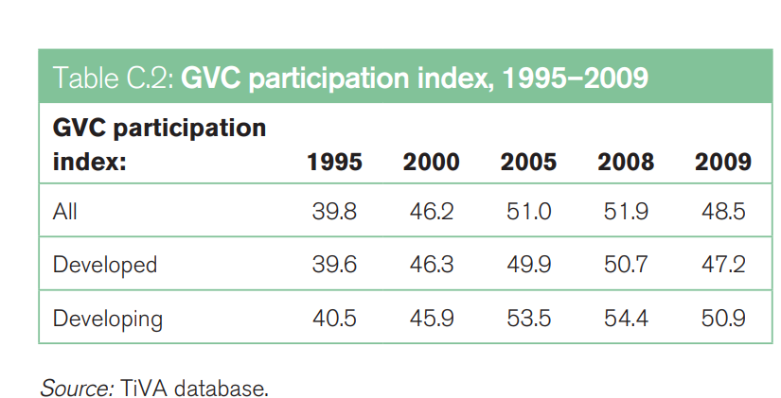
Value falls

Slide 22
3.2 Key sectors participating in the GVC
observe
Exercise
For korea vs Japan :
Compare the backward linkage (equivalent to backward participation rate) to their respective forward linkage
observe

Slide 23
Observe Asia participation in GVC
Also note the countries with a fall in the participation index

Slide 24
Observe this phenomenon

Slide 25
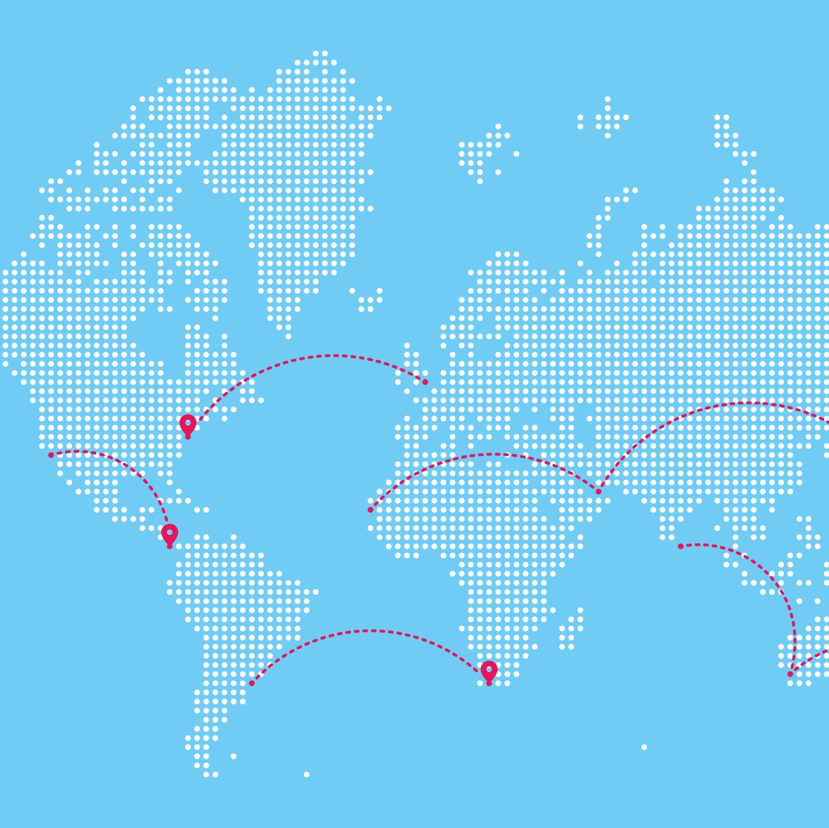
4. GVC in Asia
Why a larger share comes from Asia
Heterogenous economies in the region
Japan, Korea, SG : Knowledge based
West Asia : Resources rich
South and East Asia , India, China : Labor endowed
SE Asia : A blend of all the above
Why anchor primarily on manufactured goods ? Electronic goods ?

Slide 26
Key Observations?

Slide 27
4.2 Asia and GVC

Slide 28
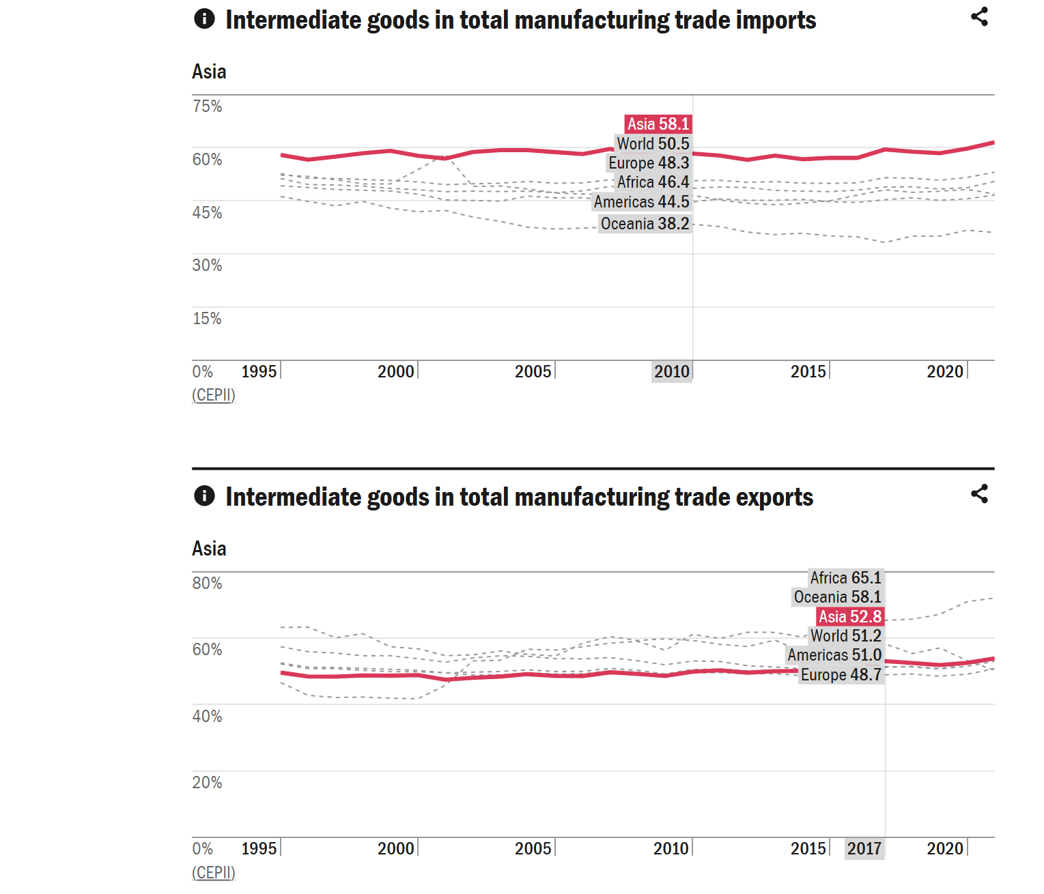
Evidence of participation in GVC
Focus on intermediate goods
Import > Export of such goods
CEPII (Centre d’Etudes Prospectives et d’Informations Internationales)

Slide 29
5. Effects of participation in GVC

Slide 30
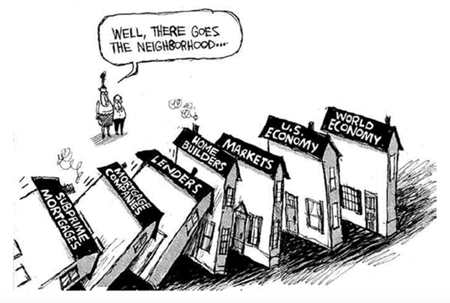
5.1 Key challenges of GVC participation
Increased vulnerability to global business cycle :
Global financial crisis in year 2008
Impact more prominent on low valued added consumer products such as clothing
Developing economies worst hit
Debt, bankruptcy, unemployment rose
Fall in demand for consumables
Insufficient liquidity for firms

Slide 31
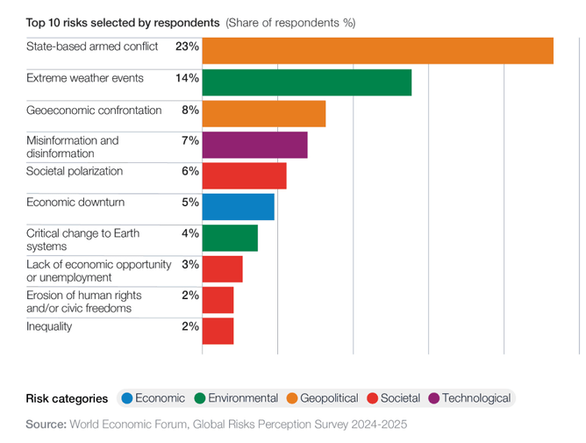
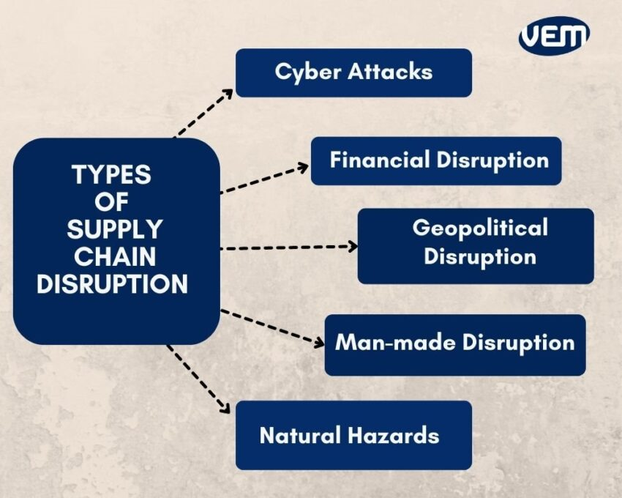
5.1 Key challenges of GVC participation
Supply chain disruptions
Natural disasters : eg flooding in Thailand
Borders access : Covid 19 pandemic
Geopolitical tensions : Esp on semiconductor supply chain
USA-Iran : Oil supply disruptions affecting energy and transport
Trump administration of various tariff rates across the world ( see working example in slide 35

Slide 32
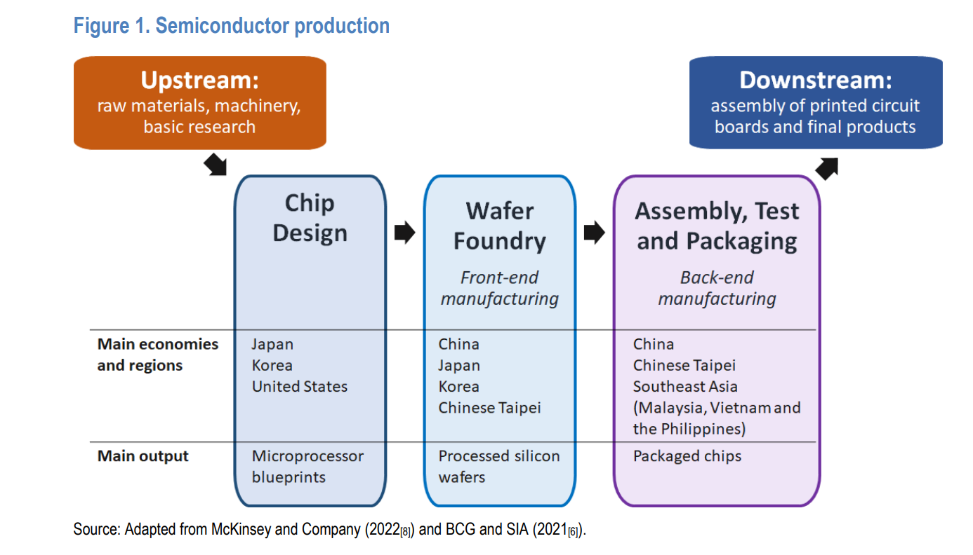
5.1. 1 Background info on supply chain of semi conductors (optional reading)
Background info:
The semiconductor industry is geographically highly concentrated, with the top-5 semiconductor-producing economies (China, Korea, Chinese Taipei, Japan USA) accounting for around three-quarters of global value added
In 2018, China, Korea and Chinese Taipei accounted for around 60% of global semiconductor value added.

Slide 33
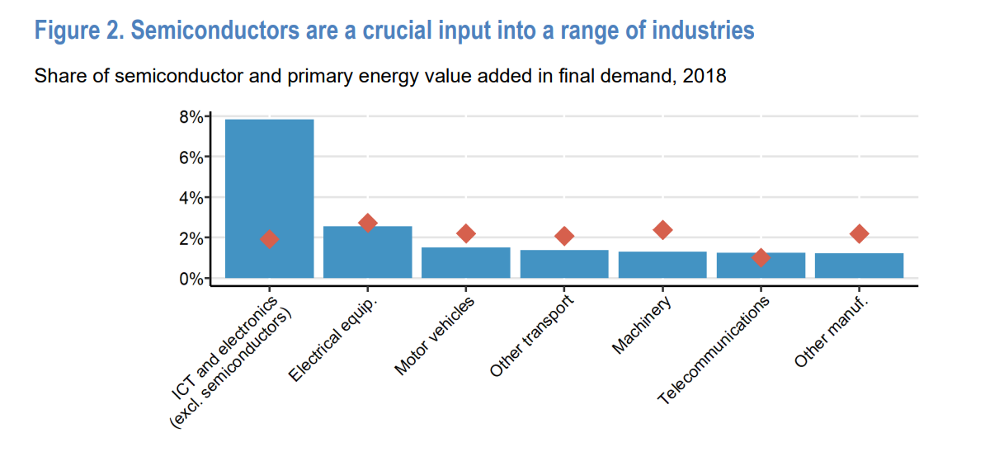
For instance, a modern car may contain 3 000 semiconductor chips, which control anything from battery management, fuel injection to infotainment systems. These shortages can have sizeable effects on aggregate output and price developments (Leibovici and Dunn, 2021[1]), with some estimates suggesting that in the first nine months of 2021 the reduction in motor vehicle production related to semiconductor shortages lowered GDP by 1½ percent in Germany and between ½ - 1% in the Czech Republic, Japan and Mexico (OECD, 2021[2]).

Slide 34

5.1 Key challenges of GVC participation
Higher Risk
(Similar risk associated to FDI )
Relocation and investment risk
Impact on labour and the environment
Narrow learning

Slide 35
Topic 07: Review : GVC participation Rate 5.2 Trade distortion and GVC
China
Country A (USA) $50
Country B (Germany : $22)
Country C (Japan $50
Country D (Korea $50)
Using our previous example on the GVC and value added in production of a smartphone
US $179
Value added = 179 – 172 = 7
Backward GVC participation = 96.1%
Import value = 172
World market

Slide 36
5.2.1 Effects of trade disintegration
Assuming the following hypothetical case of distortion
China impose 50% tariff on USA
USA set restriction that no major parts of the device can be made in Japan
USA impose a corresponding tariff of 50% on China made goods
Korean govt limit export of LED screen thus increase price of parts by 20%
Assuming The mobile device is still produced in China
China
Inflation of 5% driving up wages
a. Country A (USA) $50 X1.5 = $65
Country B (Germany : $22)
b. Country C (Japan SG: $80
c. Country D
(Korea $50 X 1.2) =$60
China new export price ( a $7 markup)
=$ 234 ( now if we mark up another 5 % due to wages ? ?
Backward GVC participation = 97% (increase )
New World price
= 234 X 1.05 = 245.7
Price in USA (w/ import tariff)
= 1.5 X 234 = $351
Vs 1.5 X 245.7 = 368.55 (USA govt earns = $ 122.85 [ From nothing]
Sum of input value = 227

Slide 37
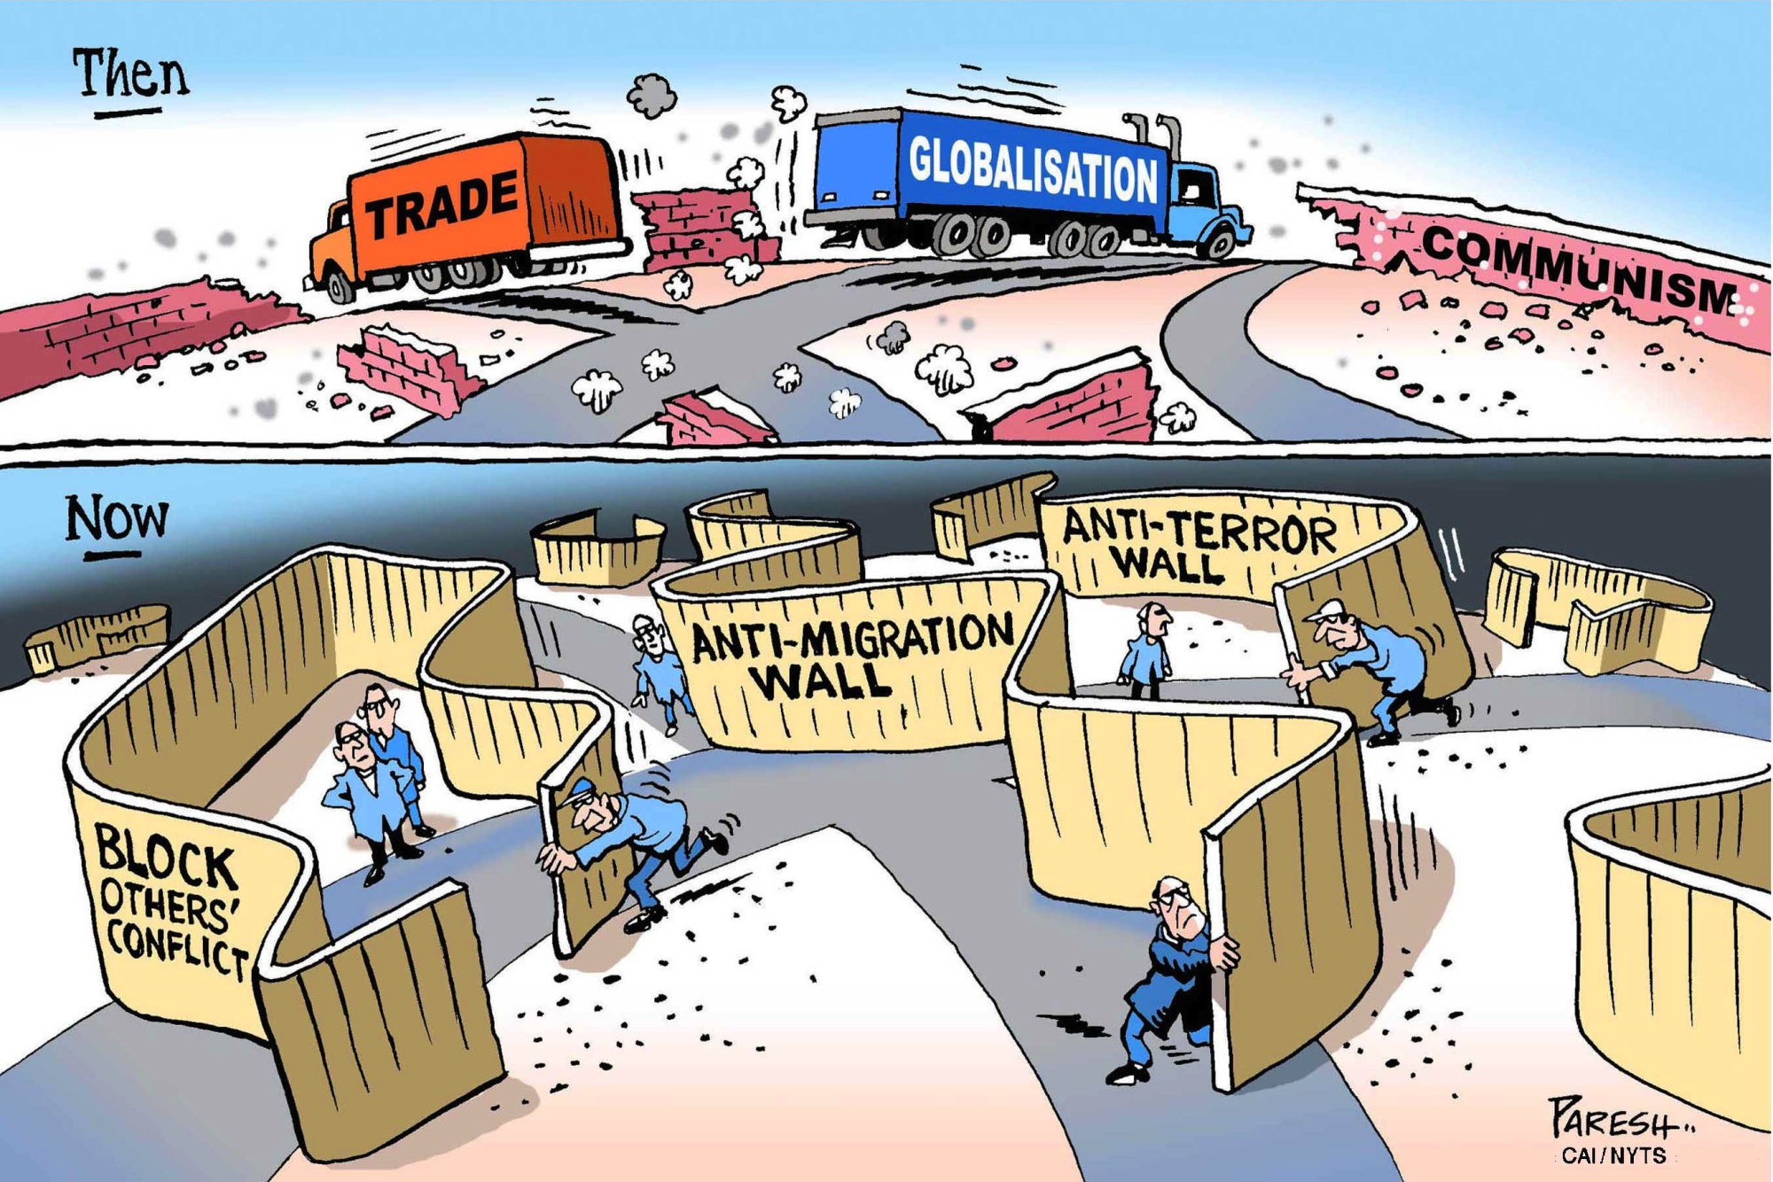
6. Future of Trade and Globalisation
Multipolar world
Slowbalistion ? Perhaps not esp for service sector esp in digital trade
Intermediate service trade
Data processing and analysis
New rule and order ?
Video Link : https://youtu.be/EOtBf5U-3d8?feature=shared

Slide 38
Key References
World Development Report 2020 : Trading for Development in the Age of Global Value Chains (Vol. 2 of 2) : Overview (English). World development indicators|World development report Washington, D.C. : World Bank Group.
http://documents.worldbank.org/curated/en/537371570778931095

